Slide 1

Basic Details of the Team and Problem Statement
Ministry/Organization Name/Student Innovation:
Ministry of Micro, Small and Medium Enterprises
PS Code: 1395
Problem Statement Title: IoT based sensors can be used to determine the Machine Runtime
Team Name: R(IOT)
Team Leader Name: ARITRA DUTTA BANIK
Institute Code (AISHE): C-6202
Institute Name: HERITAGE INSTITUTE OF TECHNOLOGY
Theme Name: AGRICULTURE, FOODTECH & RURAL DEVELOPMENT

Slide 2
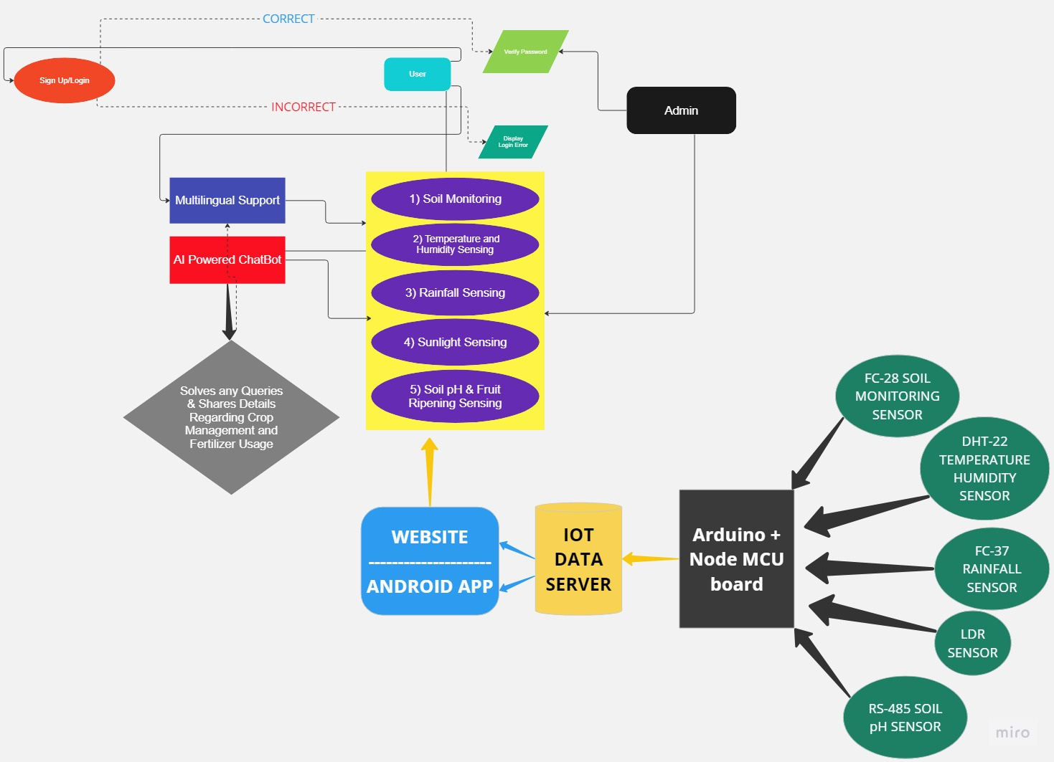
















Idea/Approach Details
Describe your idea/Solution/Prototype here:
Project Idea: IoT-Based Smart Agriculture for Enhanced Crop Management
Precision Farming: Implementing Internet of Things (IoT) technology to revolutionize traditional farming practices.
Sensor Integration: Utilizing a network of sensors including soil moisture, rainfall, soil pH, Fruit ripening sensor and climate sensors to gather real-time data from the farm.
Data-Driven Insights: Analyzing sensor data to provide farmers with precise information about soil conditions, weather patterns, and crop health.
Resource Optimization: Empowering farmers to optimize irrigation, conserve water, and protect crops from adverse weather conditions, reducing resource waste.
Crop Health Monitoring: Early detection of diseases and pests through continuous monitoring of temperature, humidity, and soil conditions
User-Friendly Interfaces: Providing farmers with user-friendly smartphone apps, web-based dashboards and an AI Chatbot to access real-time data and make informed decisions.
Sustainability: Promoting sustainable agriculture by reducing environmental impact through resource conservation and waste reduction.
Automation: Implementing automation features that control irrigation, lighting, and climate in greenhouses, reducing labor and ensuring optimal growing.
Describe your Technology stack here:
Arduino IDE
HTML 5
CSS
Javascript
Node.Js
Express.Js
React.Js
MongoDB
Android Studio
Kotlin
Java
Tensorflow.Js
Firebase
MySQL
Google Cloud
Angular.Js

Slide 3
Idea/Approach Details
Describe your Use Cases here
Describe your Dependencies / Show stopper here
Precision Irrigation:* - Use sensors to monitor soil moisture levels in real-time. - Automatically adjust irrigation systems to deliver the right amount of water.
Weather Forecast Integration:* - Incorporate real-time weather data into the system. - Receive weather forecasts and alerts. - Plan planting, harvesting, and other farm activities based on weather predictions.
Crop Health Monitoring:* - Continuously monitor temperature, humidity, and soil conditions. - Detect early signs of diseases and pests.
Resource Optimization:* - Optimize resource usage, including water and energy. - Reduce operational costs and resource wastage. - Improve overall farm efficiency and sustainability.
Remote Monitoring and Control:* - Access real-time data from anywhere via smartphone apps and web dashboards. - Remotely control irrigation, climate, and lighting in greenhouses. - Enable farmers to make informed decisions even when off-site.
Sustainable Farming Practices:* - Promote environmentally friendly farming practices.. - Support sustainability goals by conserving resources and minimizing waste.
These use cases highlight the practical benefits and applications of your IoT-based smart agriculture project, demonstrating its potential to transform traditional farming practices and enhance crop management.
Hardware Dependencies:* - Arduino Uno WiFi (ATmega328P+ESP8266) board - Sensors (Raindrop, Soil Moisture, DHT22) - Weather station - Rainfall sensor - IoT sensor nodes - Relay modules - Power supply (e.g., batteries) - LDR sensor (Light-dependent resistor)
Software Dependencies:* - Arduino IDE for programming the ATmega328P and ESP8266 - App and dashboard development tools (for user interfaces) - Python (for server-side data reception and processing)
Communication Dependencies:* - WiFi network for data transmission - Cloud storage (for storing sensor data) - Internet connectivity for cloud access
Human Resources Dependencies:* - Project team members (developers, engineers, data analysts) - Expertise in IoT, sensor integration, and programming
Financial Dependencies:* - Budget for purchasing hardware components and sensors - Funding or resources for server hosting (if applicable)
Time Dependencies:* - Project timeline and milestones - Development and testing phases
Training Dependencies:* - Training for end-users (farmers) on how to use the system effectively
These dependencies are essential for the successful implementation and operation of the IoT-based smart agriculture project. They should be carefully managed and addressed to ensure project success.

Slide 4
Team Member Details
Team Leader Name: ARITRA DUTTA BANIK
Branch : Btech Stream : CSE (Iot & CS) Year : II
Team Member 1 Name: SOUMYADIPTA DAS
Branch : Btech Stream : CSE (Iot & CS) Year : II
Team Member 2 Name: BARNIK CHAKRABORTY
Branch : Btech Stream : CSE (Iot & CS) Year : II
Team Member 3 Name: PIYUSH SAHA
Branch : Btech Stream : CSE (Iot & CS) Year : II
Team Member 4 Name: DHIMAN NAYAK
Branch : Btech Stream : CSE (Iot & CS) Year : II
Team Member 5 Name: SRIJITA CHATTERJEE
Branch : Btech Stream : CSE (AIML) Year : II
Team Mentor 1 Name: ARITRA SAHA
Category : Academic Expertise : AI/ML & NLTP Domain Experience (in years):8.5 yrs
Team Mentor 2 Name: Type Your Name Here
Category (Academic/Industry): N/A Expertise (AI/ML/Blockchain etc): N/A Domain Experience (in years): N/A

